Slide 1
Comparison of WaveQ3D to shallow water experimental data from the Florida Straits
Sean M. Reilly
OCE 673 Advanced Acoustic Propagation
University of Rhode Island
May 2012

Slide 2
Background
Several papers have recently focused on the presence of strong 3−D propagation effects in experimental data on the continental shelf in the Florida Straits area.
During a 1999 VLA experiment to estimate sediment properties from an acoustic inversion at this site, Jiang Sturm , et. al. concluded that their experiment was strongly influenced by secondary signals that originated from horizontal refraction effects.
Heaney, Ballard, et. al. found stronger evidence of horizontal refraction in this area during HLA calibration tests of the Shallow Water Array Processor (SWAP) in September of 2007 and February 2008.
These experimental results can be used as real-world validation test case for the Wavefront Queue 3-D (WaveQ3D) model.

Slide 3
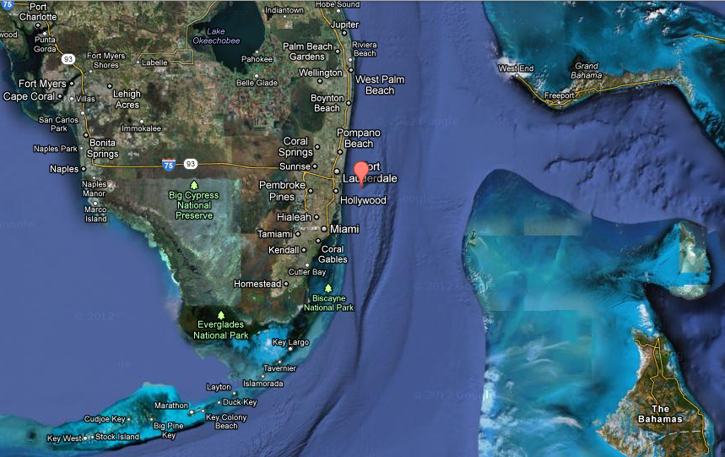
Straits of Florida
South Florida Ocean
Measurement Center
Florida
Current
image from Google Maps (http://maps.google.com)

Slide 4
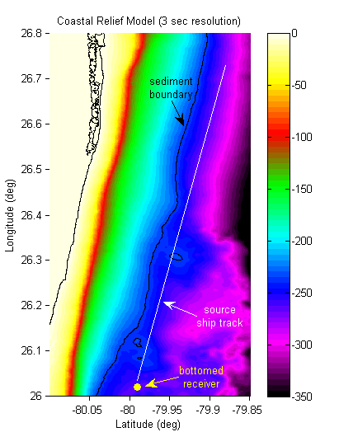
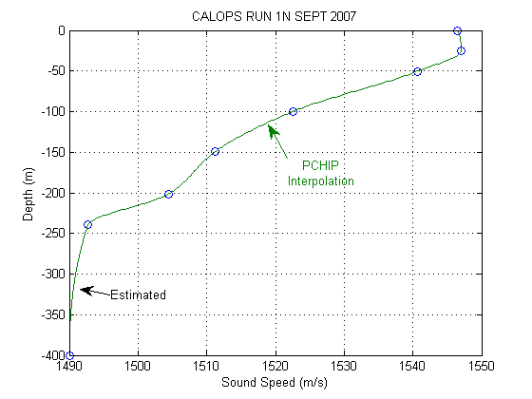
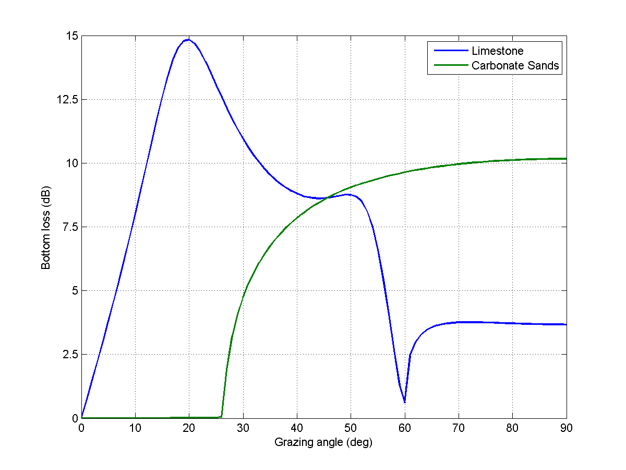
SWAP CALOPS-S Run 1A
screen
scrape
carbonate sands
limestone
Property | Limestone | Sand
Comp. wave speed (m/s) | 3000 | 1676
Comp. attenuation (dB/λ) | 0.10 | 0.01
Shear wave speed (m/s) | 1430 | 0
Shear attenuation (dB/λ) | 0.20 | 0
Density (g/cm³) | 2.40 | 1.70

Slide 5
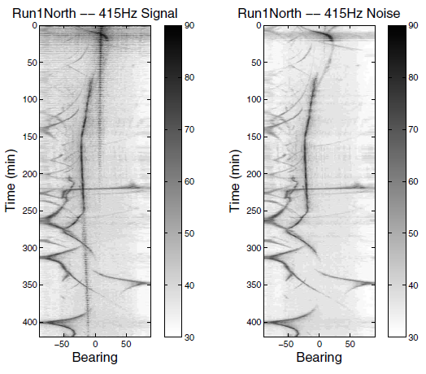
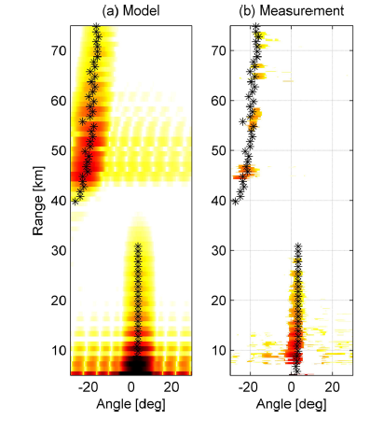
SWAP CALOPS-S Run 1A
Heaney – Bearing / Time Plots at 415 Hz
(flipped upside down)
Ballard – 3-D Normal modes at 52.5 Hz

Slide 6
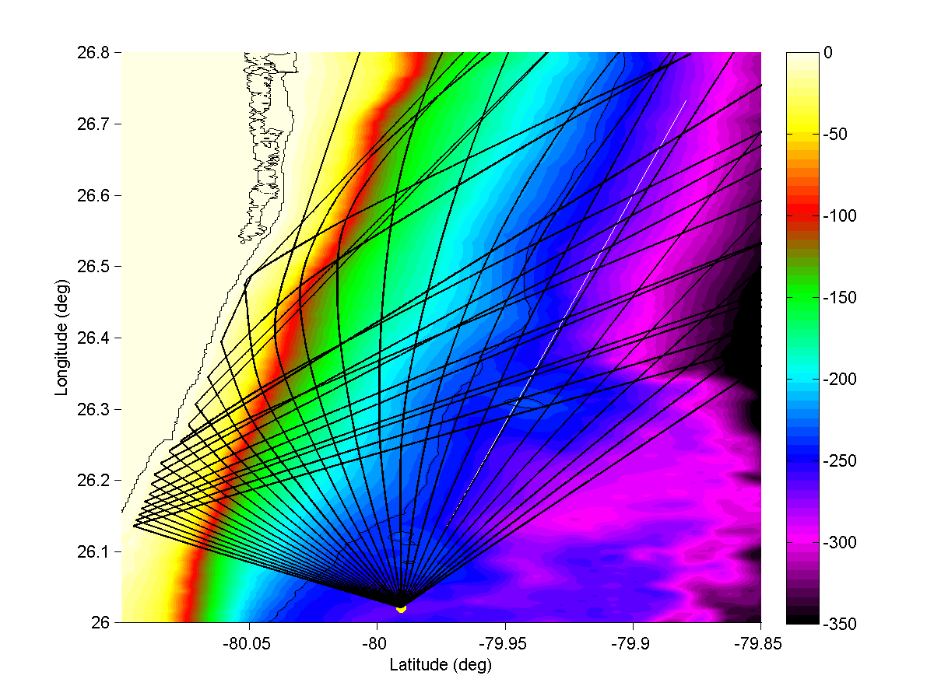
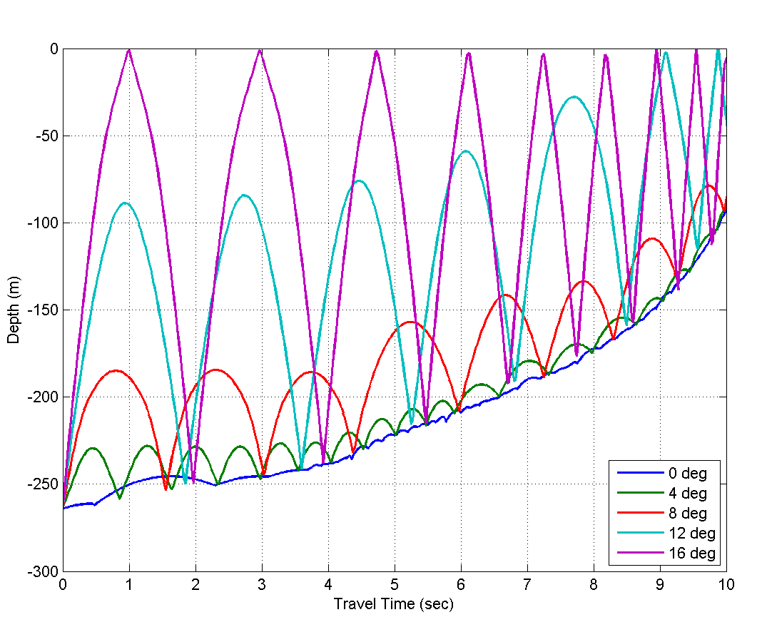
WaveQ3D Modeled Ray Paths
D/E = +2° (up), AZ = -40° to +20° by 2°
AZ = -30° (NW)
D/E

Slide 7
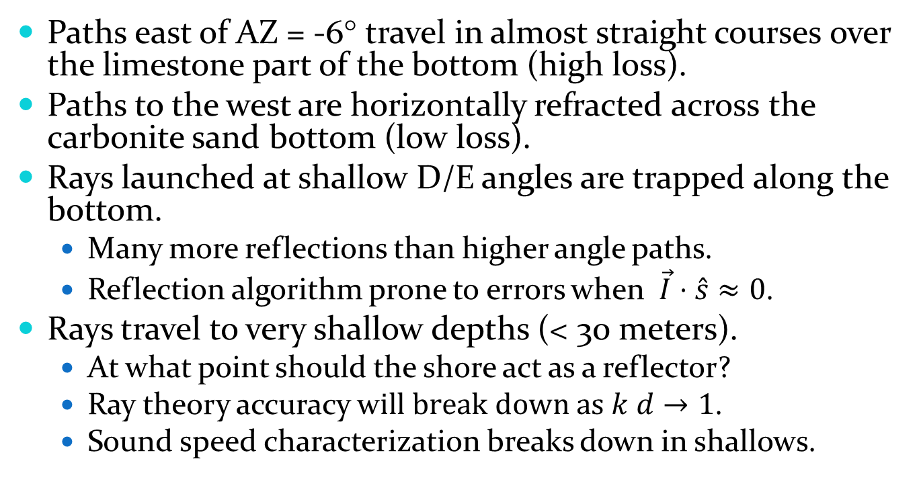
Ray Path Observations
Paths east of AZ = -6° travel in almost straight courses over the limestone part of the bottom (high loss).
Paths to the west are horizontally refracted across the carbonite sand bottom (low loss).
Rays launched at shallow D/E angles are trapped along the bottom.
Many more reflections than higher angle paths.
Reflection algorithm prone to errors when $\vec{I}⋅\hat{s}≈0$.
Rays travel to very shallow depths (< 30 meters).
At what point should the shore act as a reflector?
Ray theory accuracy w$ill break down as k d→1$.
Sound speed characterization breaks down in shallows.

Slide 8
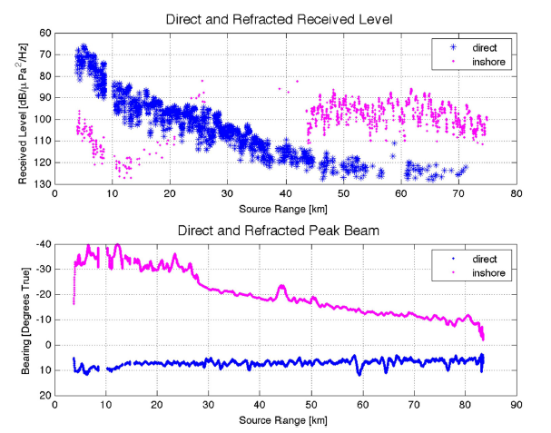
WaveQ3D Transmission Loss
Heaney results
at 206 Hz
WaveQ3D
WaveQ3D fails to detect eigenrays for the inshore path!

Slide 9
Transmission Loss Observations
WaveQ3D fails to detect eigenrays for the inshore path.
As the number of bottom interactions increases
Difficult to find any neighbors with the same # of bounces. ⇨ shortcoming of hybrid beam approach
This problem must be resolved before WaveQ3D can be validated.

